Slide 1

Institute of Engineering & Technology

Slide 2
PROJECT: Job Dekho ( APPLICATION to find Jobs)
Presented by:
201500118 Anshuman Vashishtha

Slide 3
CONTENTS
INTRODUCTION
OBJECTIVE
TECHNOLOGIES AND DESCRIPTION
FRONT END AND BACK END
SCREENSHOTS
CONCLUSION

Slide 4
INTRODUCTION
Job Dekho is a full-stack web application developed using the MERN stack that aims to provide a comprehensive platform for job seekers and employers to connect.
The website has a user-friendly interface that enables job seekers to search for job openings based on various criteria such as location, job type, and experience level.
Employers can use the website to post job openings, manage job listings, and view candidate applications

Slide 5

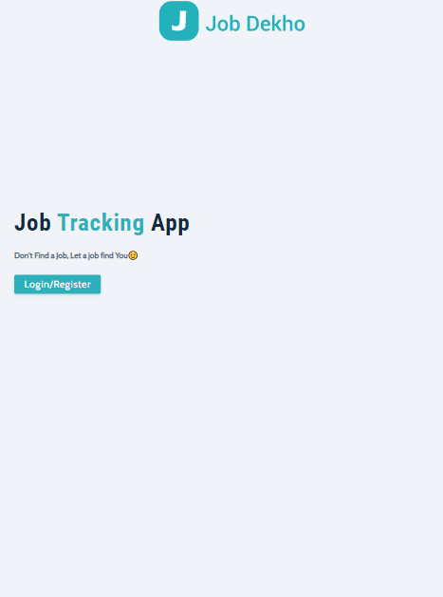

Slide 6
OBJECTIVE
Job Dekho is a mini project built using the MERN stack that aims to provide a platform to job seekers to find available job opportunities and for employers to post job openings..
The website has a user-friendly interface that allows job seekers to search for job openings by entering keywords and filters such as location, job title, and job category.
The administration panel of JobDekho allows employers to post job openings, manage job listings, and view job applications.

Slide 7
TECHNOLOGIES AND DESCRIPTION
The base technology used is MERN STACK (MongoDB,Express,ReactJS,NodeJS).
The architecture allows you to easily construct a three-tier architecture (front end, back end, database) entirely using ReactJs

Slide 8
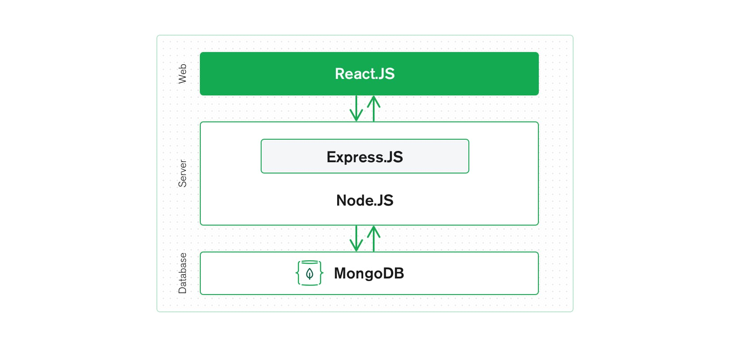

Slide 9
MongoDB — document database
React(.js) — a client-side JavaScript framework
Node(.js) — the premier JavaScript web server
ReactJS is a declarative, efficient, and flexible JavaScript library for building reusable UI components. It is an open-source, component-based front-end library that is responsible only for the view layer of the application.
Node makes up the middle (application) tier. Node.js is a popular and powerful JavaScript server platform. Regardless of which variant you choose, it is the ideal approach to working with JavaScript and JSON, all the way through.
MongoDB is a distributed database at its core, so high availability, horizontal scaling, and geographic distribution are built in and easy to use

Slide 10
PROJECT VISUALIZATION
FRONT END :
React.js front end
The top tier of the MERN stack is React.js, the declarative JavaScript framework for creating dynamic client-side applications in HTML. React lets you build up complex interfaces through simple components, connect them to data on your back-end server, and render them as HTML.
React’s strong suit is handling stateful, data-driven interfaces with minimal code and minimal pain, and it has all the bells and whistles you’d expect from a modern web framework: great support for forms, error handling, events, lists, and more.

Slide 11
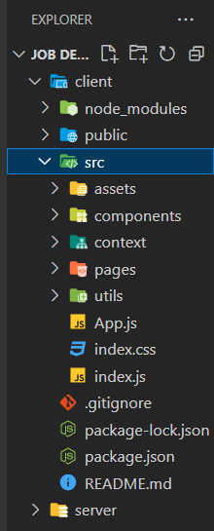
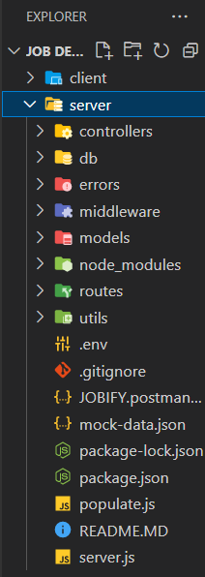
Front-End Folder and Visualisation

Slide 12
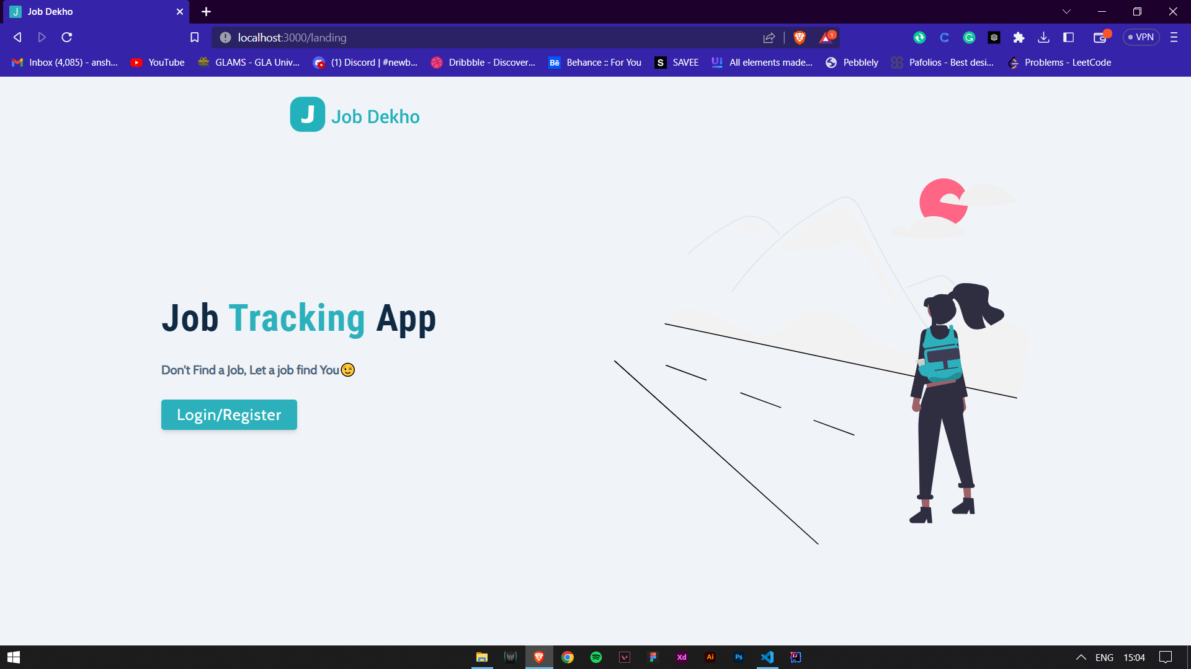
Front Page

Slide 13
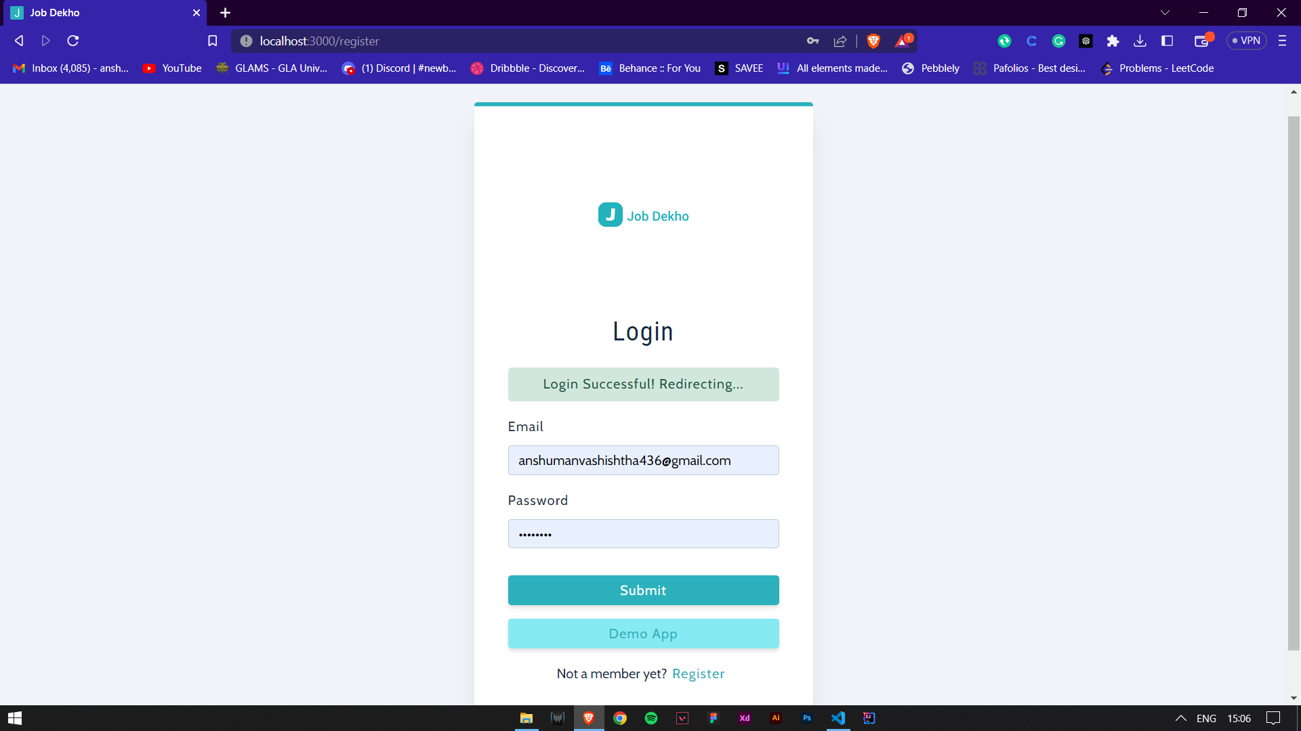
Login Page

Slide 14
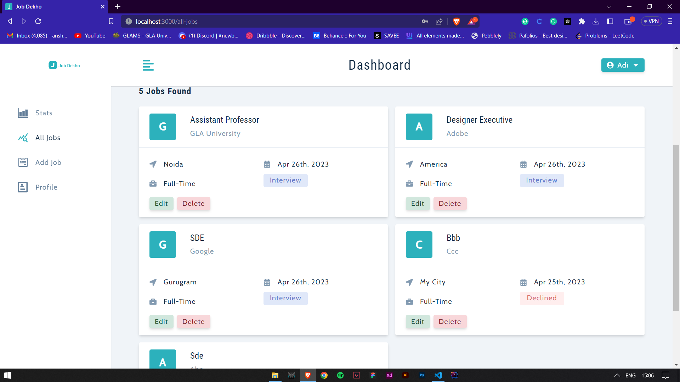
To Search for Jobs where from administration side we can perform all CRUD operations

Slide 15
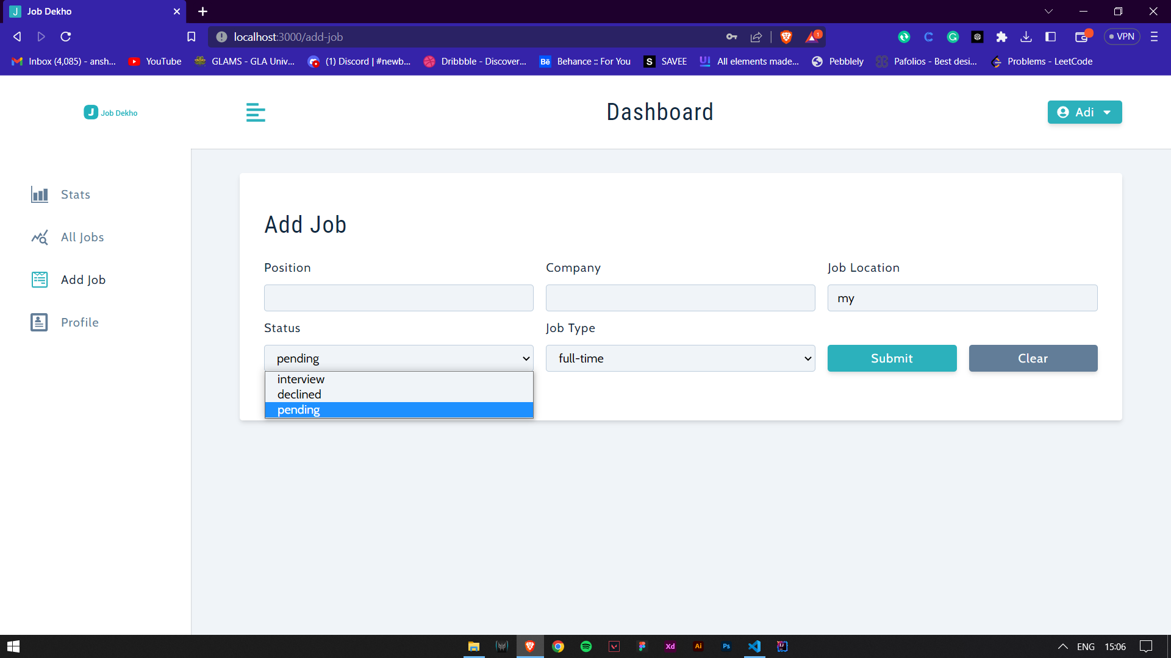
Dashboard for Adding Jobs.

Slide 16
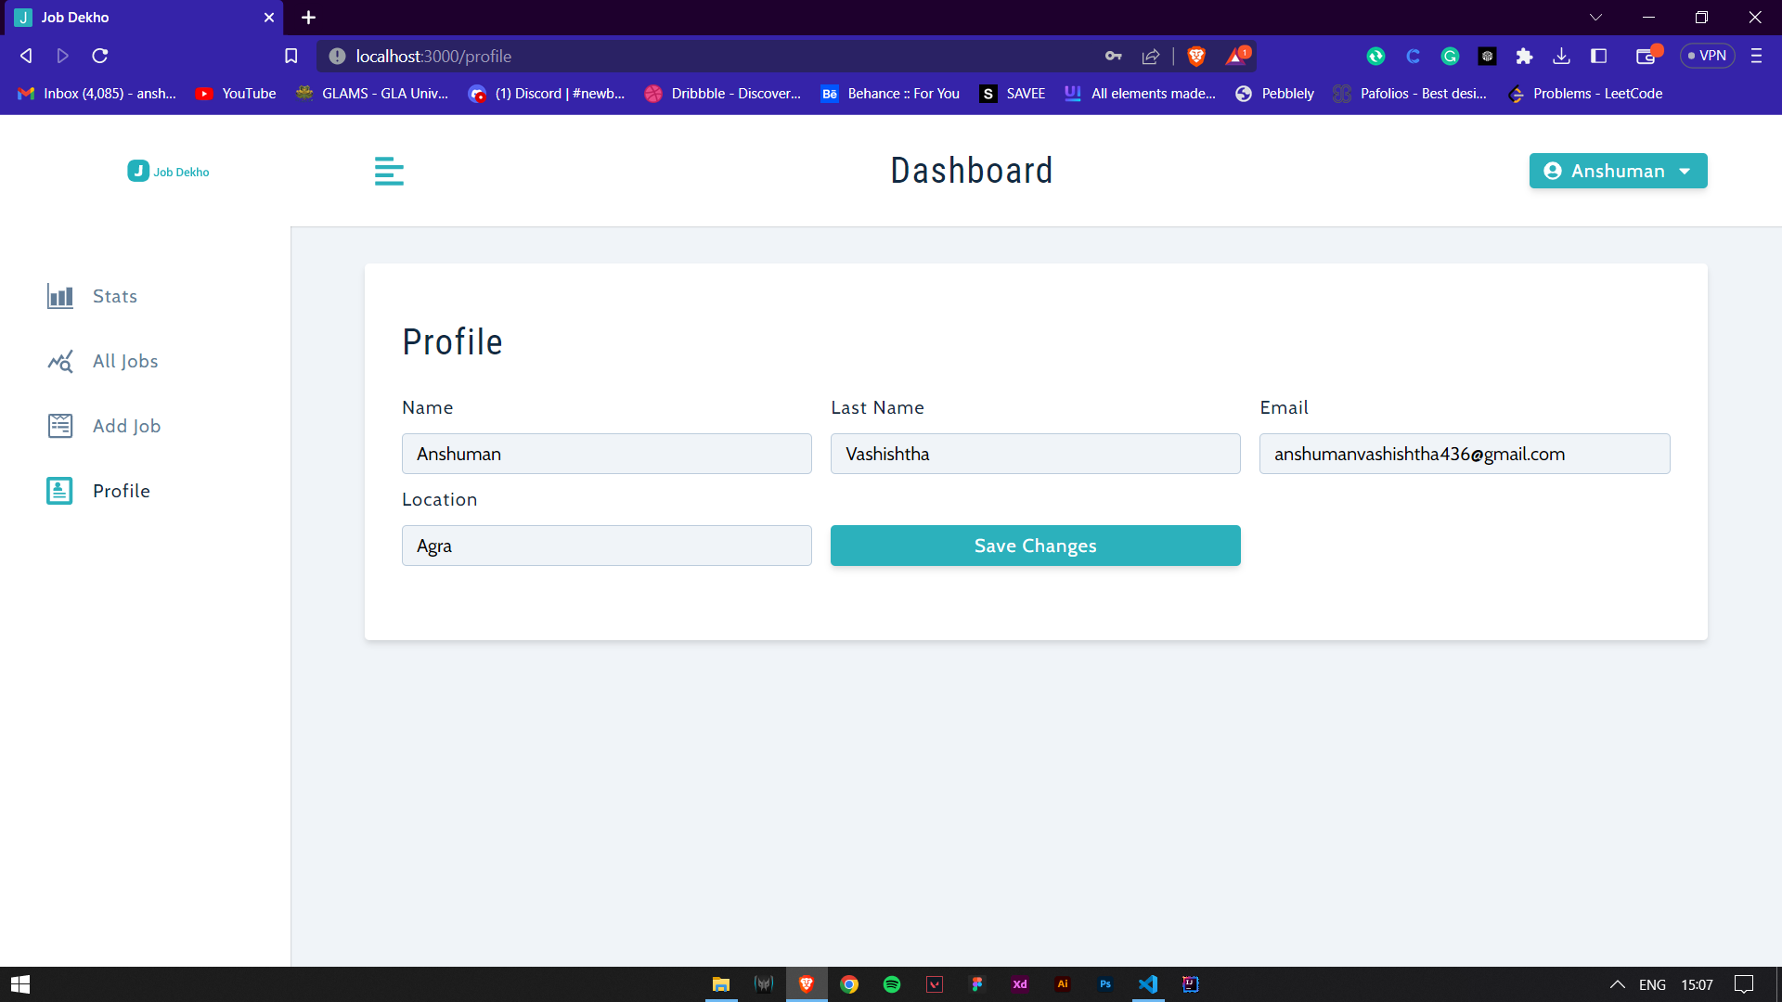
Dashboard editing Profile

Slide 17
MongoDB database The application stores any data (user profiles, content, comments, uploads, events, etc.), then you’re going to want a database that’s just as easy to work with as React, Express, and Node. That’s where MongoDB comes in: JSON documents created in your React.js front end can be sent to the Node.js server, where they can be processed and (assuming they’re valid) stored directly in MongoDB for later retrieval.

Slide 18
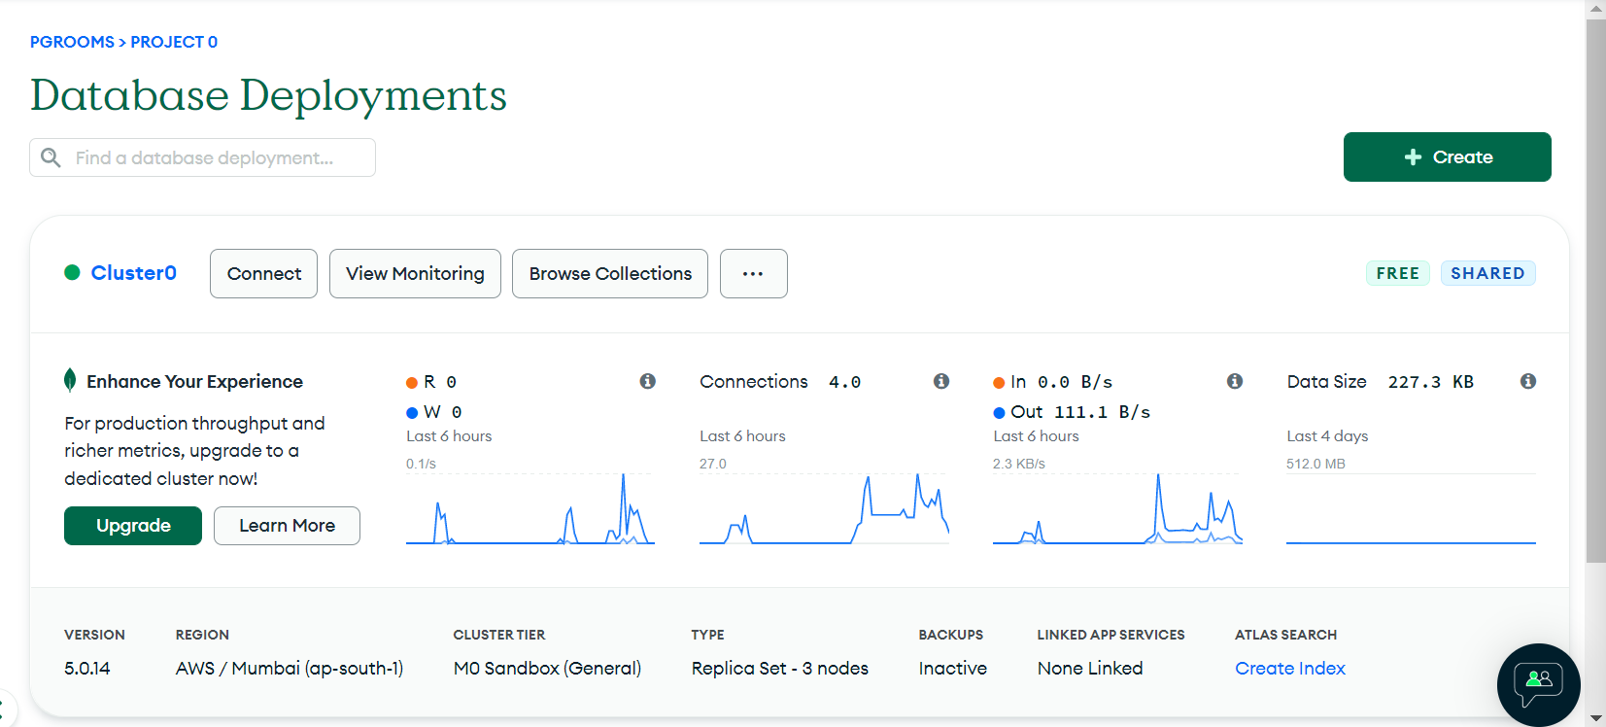
Database Folder and Visualization

Slide 19
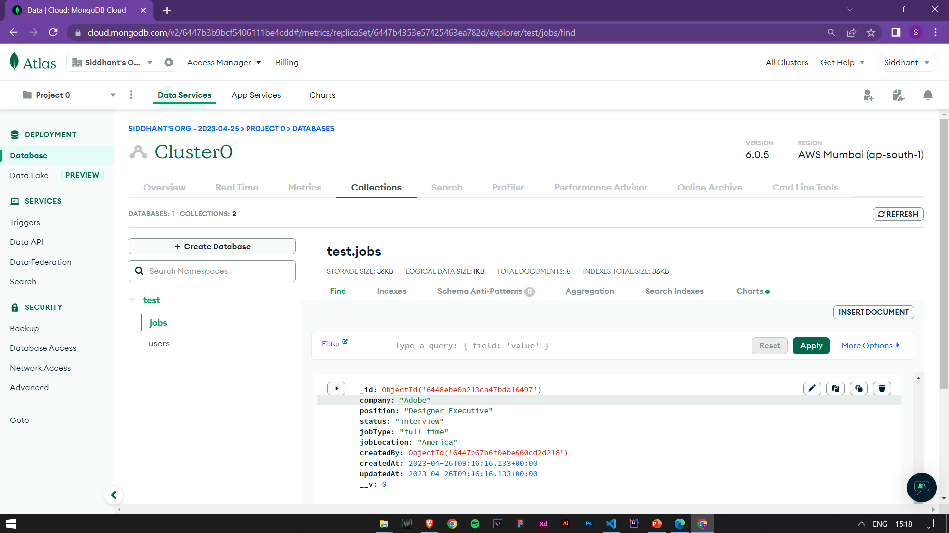
Job Profiles In database

Slide 20
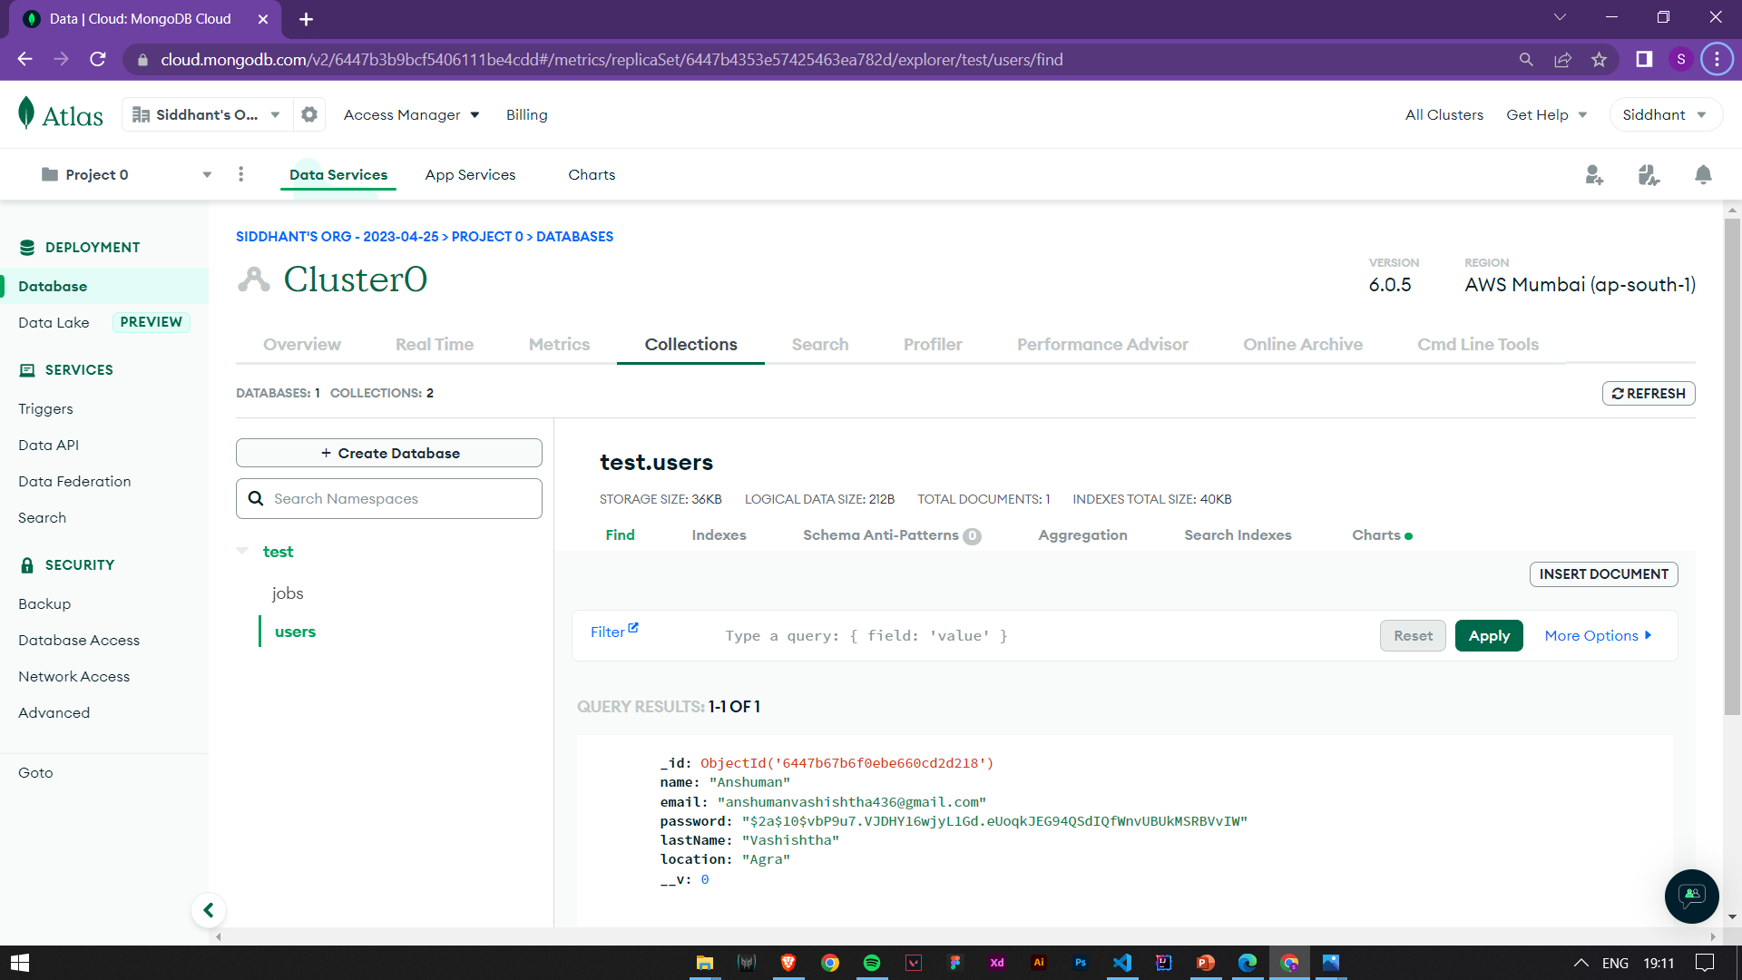
User In Database

Slide 21
CONCLUSION AND SCOPE
There is always room for improvements in any application, however good and efficient it may be. But the most important thing should be flexible to accept further modifications. Right now we are just Building a Working MERN Stack Project which might be helpful in finding Job’s for people but in the future, we can also create a panel for Recruiters so that they can post information regarding Jobs.

Slide 22
THANK YOU

